Slide 1
Let save rhinos

Slide 2
RHINOS POPULATION

Slide 3
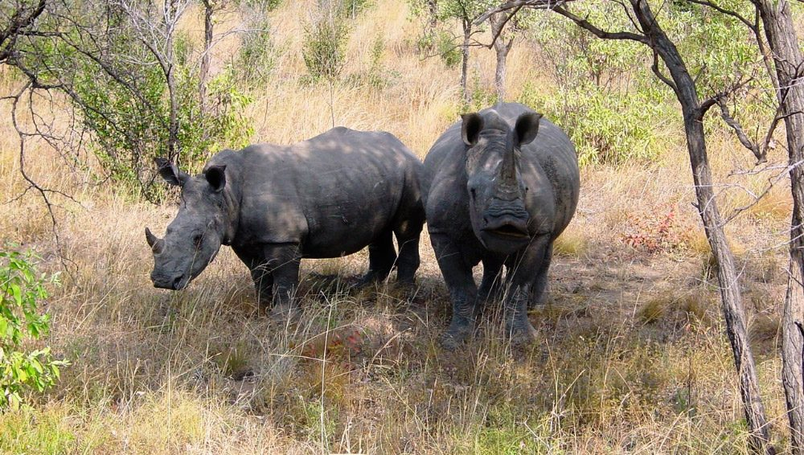
HABITAT
Rhinoceroses are fairly hardy animals and can survive in a range of different habitat types. They can naturally be found throughout Asia and Africa and their habitat ranges from give rainforests and swamps to grassy plains. Typically, rhinos are solitary animals, although not unsociable when they meet one another in the wild. White Rhinos are an exception to this rule, and prefer to live in small herds, made up mostly of females.

Slide 4
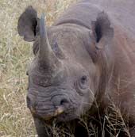
Black rhino
The black rhino is smaller than the white rhino, although adults can still reach 1.5 meters in height and weigh in at 1.4 tones.
The species is distinguished from the white rhino by a prehensile upper lip (hence the alternative name of hook-lipped rhino), which it uses to feed on twigs of woody plants and a variety of herbaceous plants. They have a particular liking for acacias.

Slide 5

White rhino
White rhinos are the second largest land mammal and their name comes from the Afrikaans's, a West Germanic language, word “weit” which means wide and refers to the animal’s muzzle. Also known as the square-lipped rhinoceros, white rhinos have a square upper lip with almost no hair. The majority (98.8%) of white rhinos occur in just four countries: South Africa, Namibia, Zimbabwe, and Kenya. Northern white rhinos and southern white rhinos are genetically distinct subspecies and are found in two different regions in Africa.

